Slide 1

Sentiment Analysis of Amazon Product Reviews:
Predicting Customer Satisfaction
Name: Pankaj Devikar
Institute: Digicrome Academy

Slide 2
INTRODUCTION
Project Scope
Project Purpose
Understand the sentiment
Address class imbalance
Implement classifiers and advanced techniques
Evaluate model performance
Compare traditional machine learning algorithms with neural network approaches.
Explore topic modeling techniques
The core objective of the project, which involves analyzing and predicting the sentiment or satisfaction levels of customers based on their reviews of Amazon brand products.

Slide 3
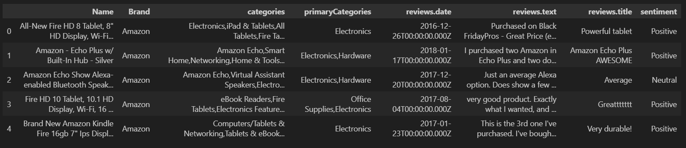
DATA OVERVIEW
Key Dataset Features
Data Points
Target
Sentiment
Positive
Neutral
Negative
Name
Brand
Categories
primaryCategories
review.date
reviews.text
reviews.title

Slide 4
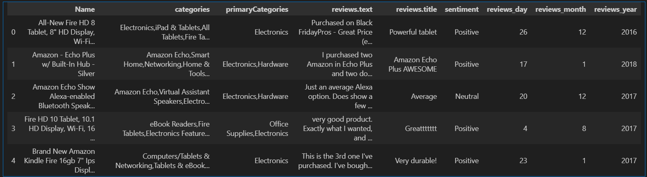
DATA PREPROCESSING
Creating New Columns
Creating new columns, such as
reviews_day, reviews_month, reviews_year
Cleaning and Preparing Data
Handling missing values, imbalanced data and Label Encoder

Slide 5
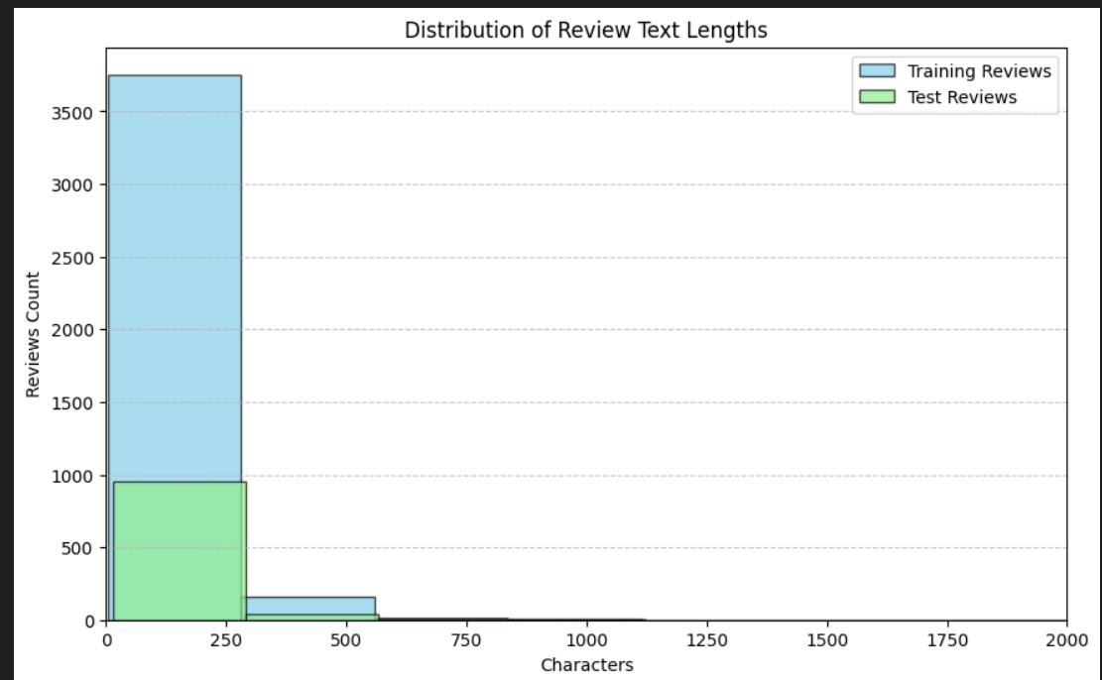
Visualization
Review counts according to their review text length for training and testing dataset.

Slide 6
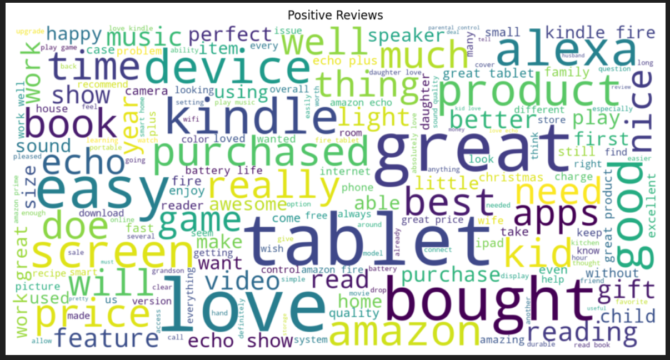
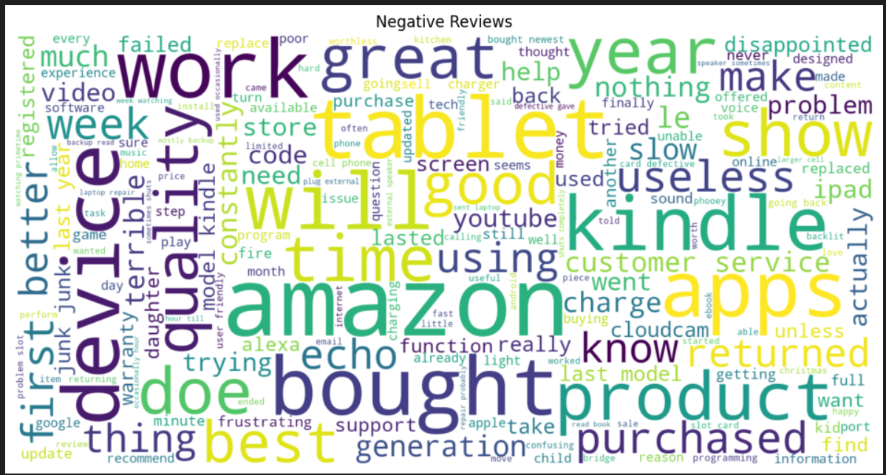
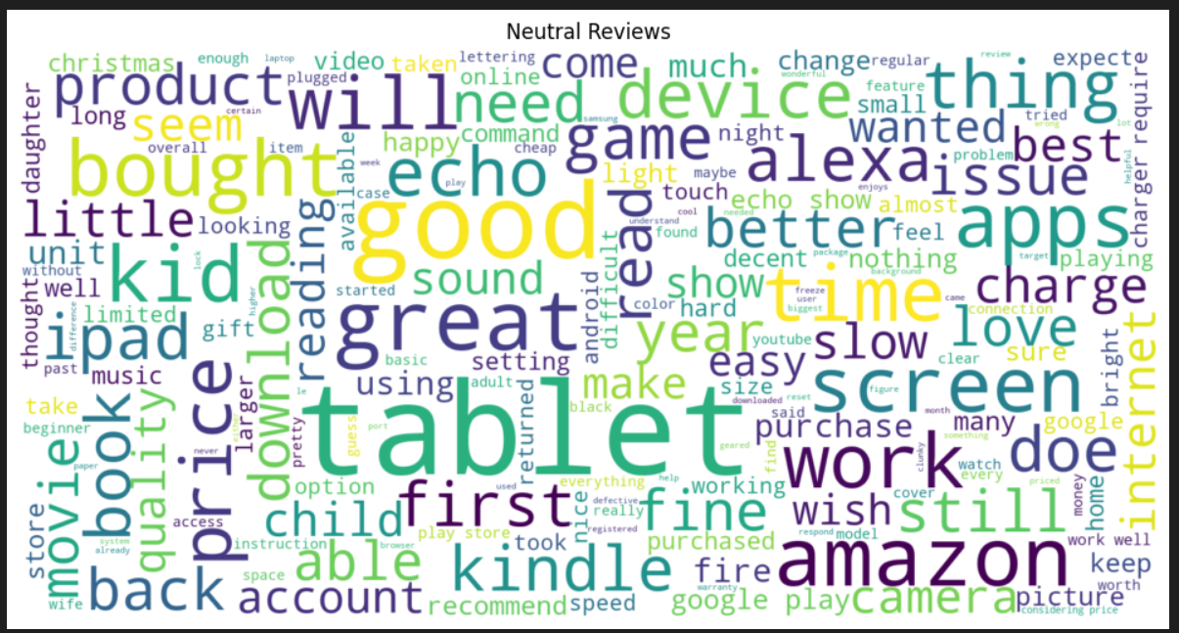
WordCloud

Slide 7
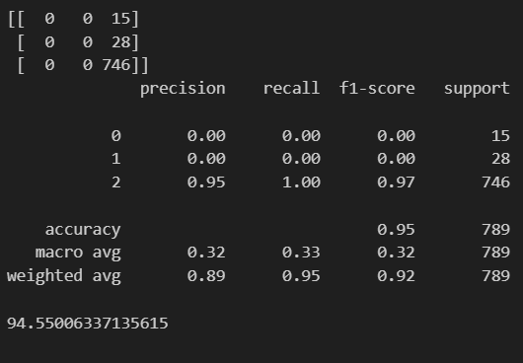
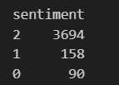
The multinomial naive bias model is fitted with training data with TFIDF vectorizer.
It shows that data is imbalanced towards positive reviews.

Slide 8
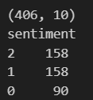
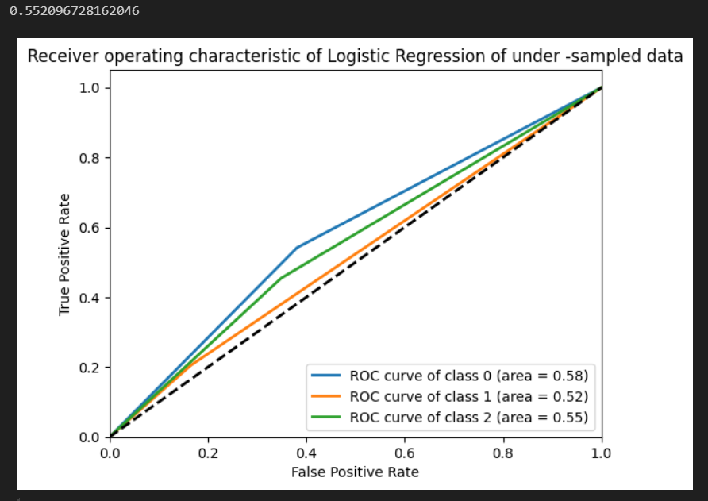
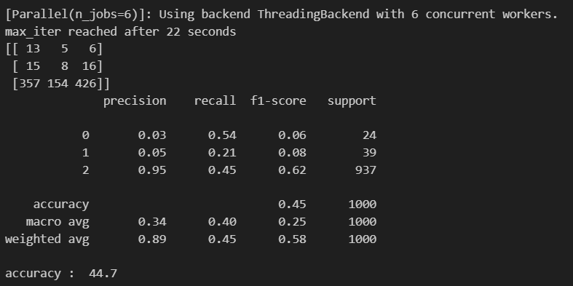
UnderSampling
Logistic regression applied on under sampled data with TFIDF vectorizer and gives accuracy as 44.7%

Slide 9
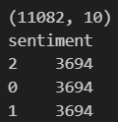
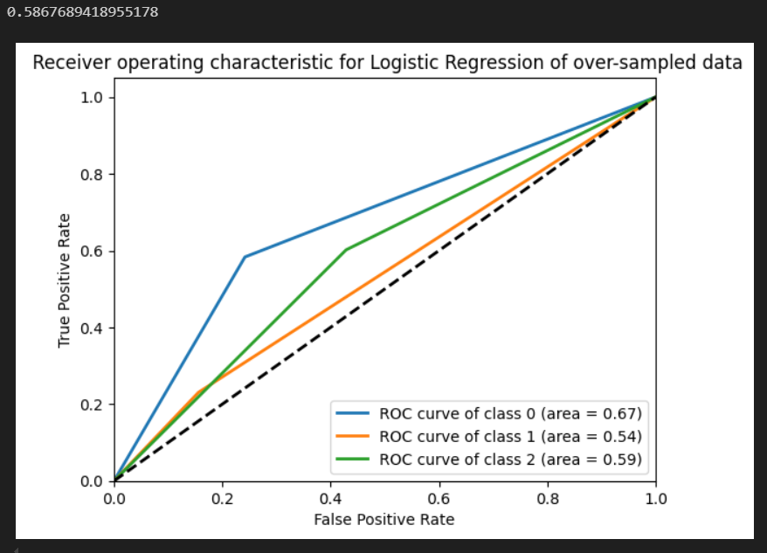
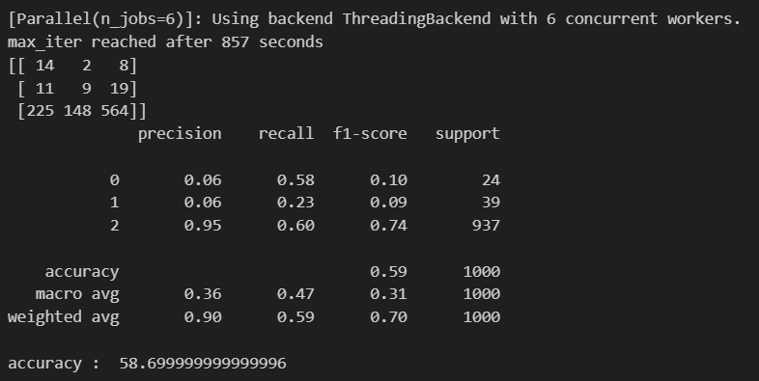
OverSampling
Logistic regression applied on over sampled data with TFIDF vectorizer and gives accuracy as 58.69%.
This shows that over sampled data has better accuracy.

Slide 10
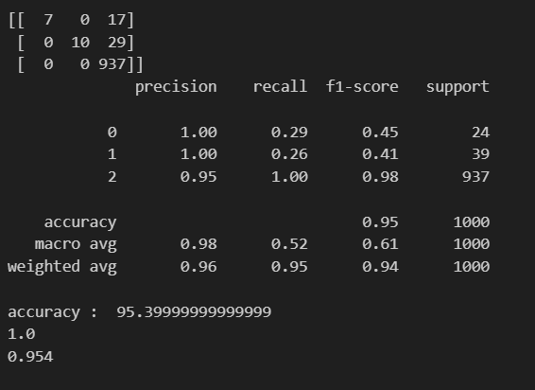
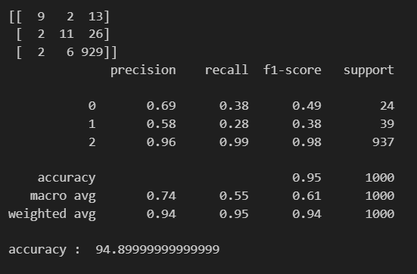
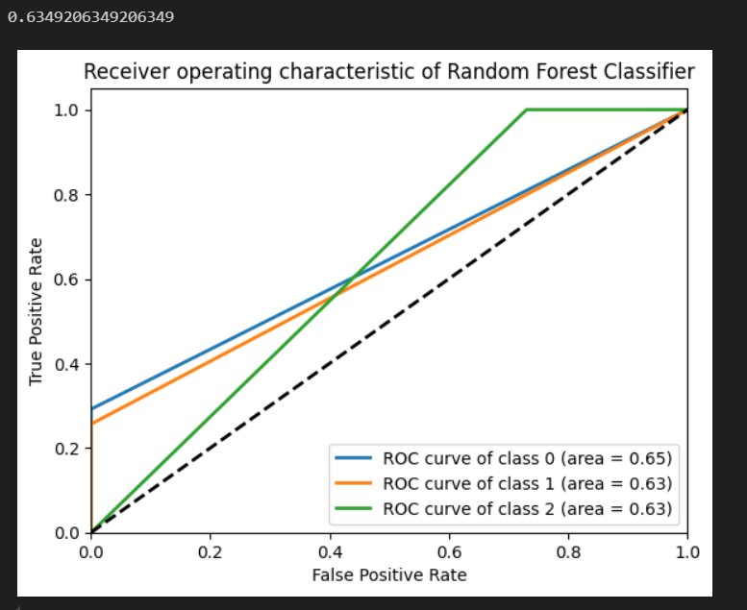
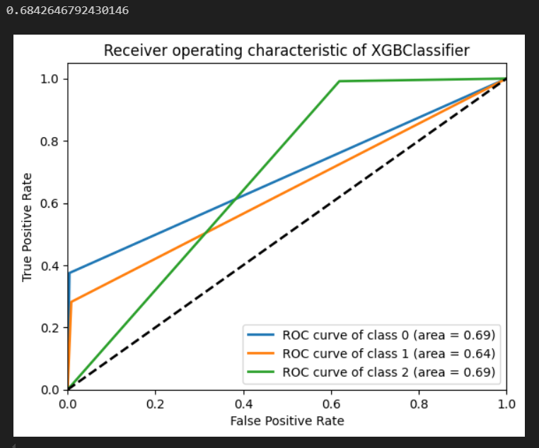
Random Forest Classifier
XG Boost Classifier
We can see that XGBoost is performing better in predicting all the classes.

Slide 11
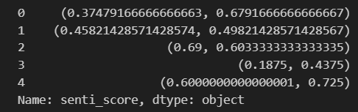
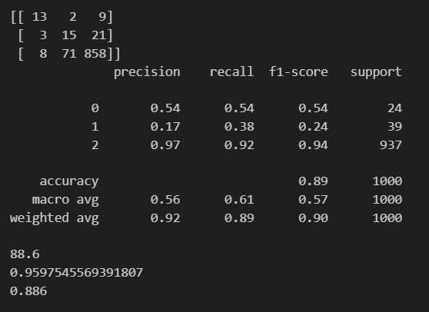
Sentiment Score
Sentiment Score does not have much affect on the performance

Slide 12
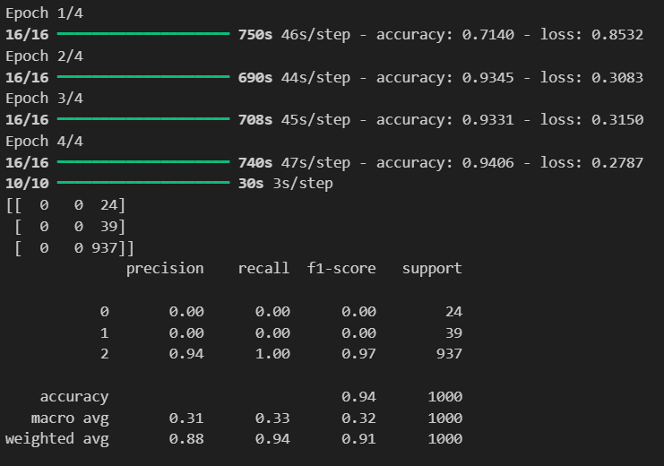
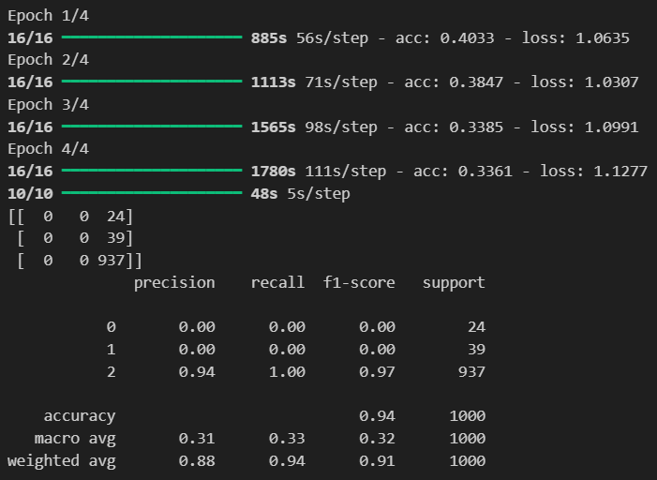
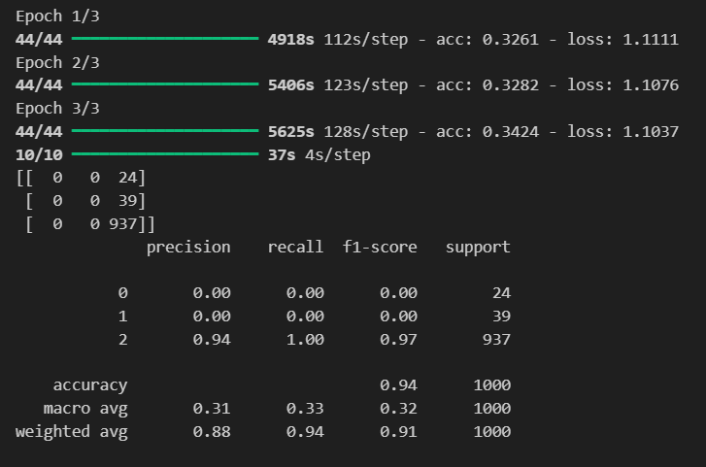
Deep Learning
LSTM
LSTM with Class weights
LSTM with Over sampled data
We can see from above that LSTM and GPU models are not efficient in predicting minor classes. ANN is performing quite good in solving class imbalance problem but it cannot beat traditional ML agorithms.

Slide 13
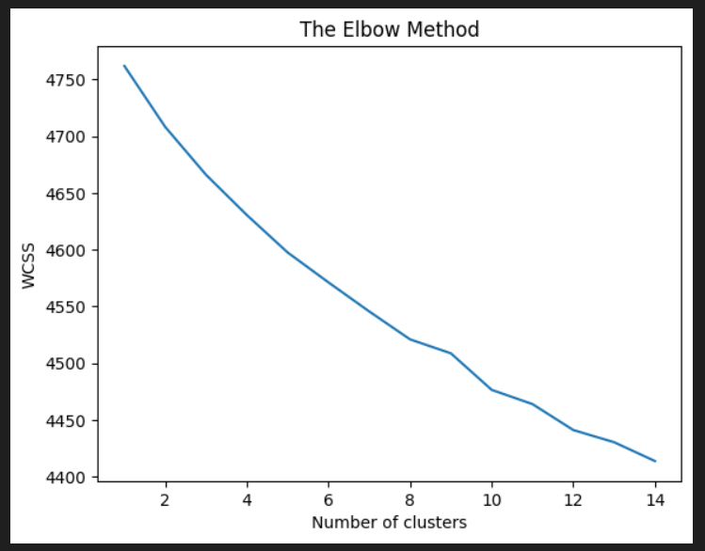
Elbow Method for cluster
As no proper elbow is generated, I will have to select right amount of clusters by trial and error. So, I will showcase the results of different amount of clusters to find out the right amount of clusters.

Slide 14
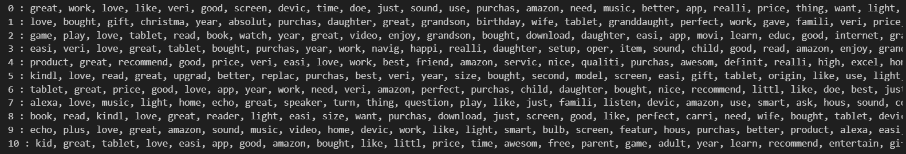
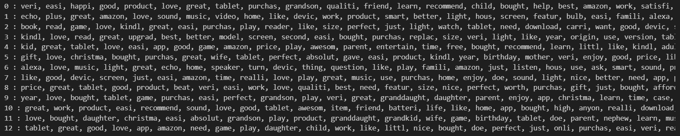
11 cluster outcome
13 cluster outcome

Slide 15
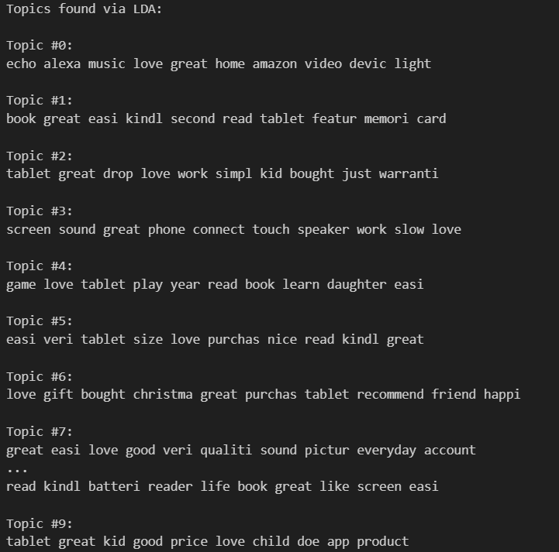
Topic modelling outcome
The project successfully combined sentiment analysis, machine learning, and topic modeling to predict customer satisfaction.
The findings provide actionable insights for improving product features, marketing strategies, and customer experience.

